Slide 1
KS3 Science
Welcome to KS3 Science at Langdon Park School.
Here at LPS we aim to make pupils who think like scientists and are resilient, lifelong learners with a deep understanding of the world around them. We want our pupils to be well equipped with ambition and aspirations so they become valuable members of society.
Mr Ally: KS3 Coordinator

Slide 2
Topics
In science we make learning a journey which covers the three components of science. Biology, Chemistry and Physics. Our students work to discover enquiry questions which covers the national curriculum.
What is the Universe made of?
How big is the solar system? Why do we experience different seasons in different countries?
How do micro-organisms play a role to keep us alive?
How will we generate energy in the future?
Why is it important to ensure balance within an ecosystem?
Would we weigh the same on the moon?
What are chemical reactions and why are they useful?
How are new humans made and why do they look different from each other?
Why can we see different objects and colours?
How can we explain electric shocks and lightning?

Slide 3
Why is science important/ fun facts
Science satisfies curiosity about phenomena with explanations
Science helps you to question and discuss science-based issues
Without Science we’d have no way to use electricity and no modern technology
Without Science we’d have no modern farming for food
Science is used in modern medicine. Doctors are risking their lives to save ill people. Scientists are currently working very hard to produce a vaccine for the Covid-19 virus.
Science teaches you to examine problems, consider many alternatives and devise strategies for finding out the ‘real’ answer.
You are bombarded with information every day – how do you sort out what is true and what is not?

Slide 4
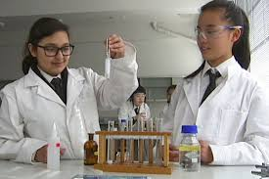
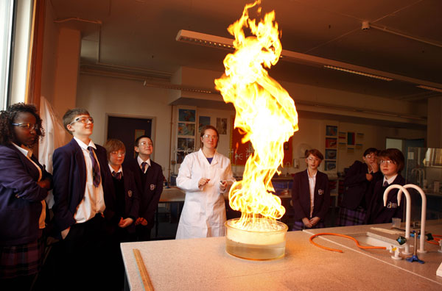
Here at LPS we want our students to feel like scientists! You will have your science lessons in labs and you will devise your own practical activities.
Your new teachers will have a vast experience of being a scientist and will do their best to ensure you succeed!

