Slide 1
LPS Student Bulletin
Week 3B
Week Beginning 17.06.24
Assembly Theme:
Student Leadership Campaign Trail – Prefects
Be Professional
SDC Calendar – Upcoming Events:
Progress Review Day – 27th June 2024
Character Development Day – 2nd July 2024
Rewards Trips – 3rd July 2024
Awards Evening – 18th July 2024
Sports Day – 19th July 2024
Follow us on Twitter for updates:
@langdon_park
PROFESSIONAL
INCLUSIVE
A LEARNER
KNOWLEDGEABLE

Slide 2
Eid ul-Adha
Eid ul-Adha ('Festival of Sacrifice') is one of the most important festivals in the Muslim calendar.
The festival remembers the prophet Ibrahim's willingness to sacrifice his son when God ordered him to
https://www.bbc.co.uk/bitesize/articles/zhjjf4j
PROFESSIONAL
INCLUSIVE
A LEARNER
KNOWLEDGEABLE

Slide 3
Student Leadership Campaign
Campaign Week – WB 17th June 24
This week students running for senior student leadership positions will deliver a 1 slide pitch outlining the ideas they would like to see at LPS.
Posters and pitching will take place throughout next week
Polling cards will be given to form tutors before Thursday 20th June.
Tannoy reminder on Friday
Polling stations will open during lunchtime on Friday where the shout out wall takes place.
PROFESSIONAL
INCLUSIVE
A LEARNER
KNOWLEDGEABLE

Slide 4
PE Enrichment Timetable - HT6
 | Club | Staff | Students | Location | Time
Monday | Tennis | CSA | All Years | Tennis Courts | 12:45 – 13:25pm
 | Softball / Rounders | JCH / KMP | All Years | Football Pitch | 3:10 - 4:10pm
 | Gym Club (GIRLS ONLY) | DHE | All Years | Gym | 3:10 - 4:10pm
Tuesday | Tennis | CSA | All Years | Tennis Courts | 12:45 – 13:25pm
Wednesday | Tennis | CSA | All Years | Tennis Courts | 12:45 – 13:25pm
 | Gym Club | ZAH | All Years | Gym | 3.10 – 4.10pm
 | Dance | MRE | All Years | Dance Studio | 3.10 – 4.10pm
 | Basketball Club | JCH | All Years | Outdoor Courts | 3.10 – 4.10pm
Thursday | Tennis | CSA | All Years | Tennis Courts | 12:45 – 13:25pm
 | Athletics | All Staff | All Years | Football Pitch | 3.10 – 4.10pm
Friday | Tennis | CSA | All Years | Tennis Courts | 12:45 – 13:25pm

Slide 5
 | OPENS | JAMM’AH | LOCATION
MON | 13:00 | 13:15 | ASSEMBLY HALL
TUES | 13:00 | 13:15 | ASSEMBLY HALL
WED | 13:00 | 13:15 | ASSEMBLY HALL
THUR | 13:00 | 13:15 | ASSEMBLY HALL
FRI | 12:45 | 13:05 | SPORTS HALL
*Jumm’ah locations may vary due whole schools exams. Please ask a member of staff for further updates
Please ensure your bags and coats are neatly tidy to avoid to much clutter
Ensure NO fire door exits are blocked.
You are responsible for your own belongings.

Slide 6
Achievement
Celebrating the form classes that have achieved the most achievement points last week. Well done to you all. Lets keep It up ☺
Year 7
7L – 199 Achievement Points
Year 10
10L – 98 Achievement Points
Year 8
8L – 174 Achievement Points
Year 9
9A – 95 Achievement Points
PROFESSIONAL
INCLUSIVE
A LEARNER
KNOWLEDGEABLE

Slide 7
Best Attendance so far this Academic Year
Best Att%
Worst Att%
1
7D
1
11D
2
7N
2
11P
3
7L
3
11G
PROFESSIONAL
INCLUSIVE
A LEARNER
KNOWLEDGEABLE

Slide 8
Anti- Bullying Campaign
PROFESSIONAL
INCLUSIVE
A LEARNER
KNOWLEDGEABLE

Slide 9
Anti- Bullying Campaign
We have spent a lot of time in assemblies and in class discussing the importance of kindness and empathy. As we reach the end of the academic year, let’s review best practice.
Where have you witnessed or experienced kindness or empathy in school? How did it make you feel?
What small actions can we undertake to be more empathetic and compassionate in our daily lives? Are there any you have carried out yourself?
Tutors, please give an inclusion achievement point to any tutee who you feel has gone above and beyond to show kindness and empathy.
PROFESSIONAL
INCLUSIVE
A LEARNER
KNOWLEDGEABLE

Slide 10
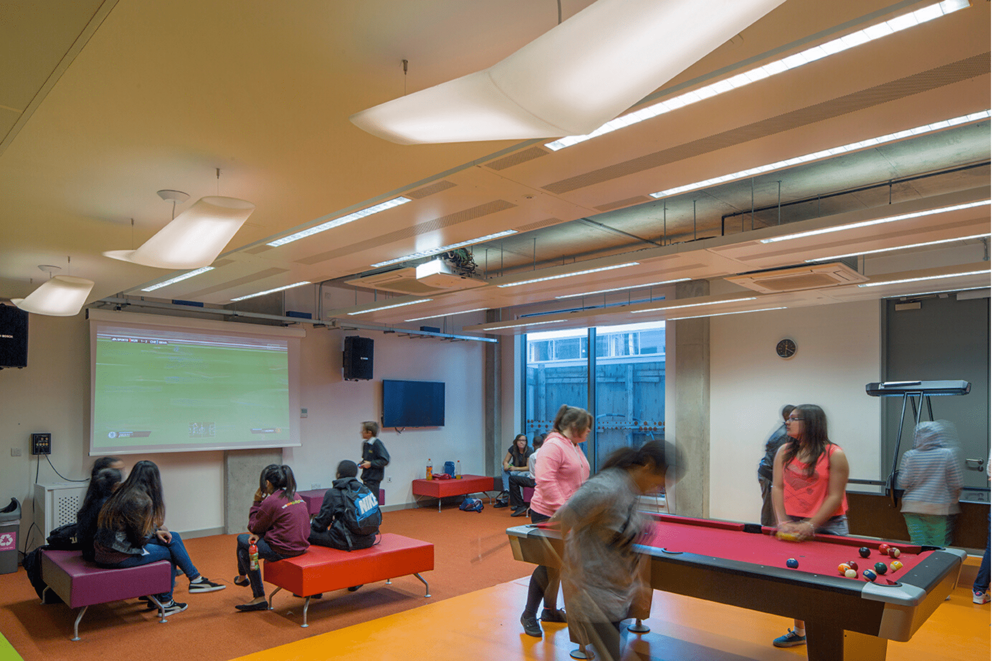
Student ambassador led drop-ins
What: Wellbeing drop in clinic
Where: Spotlight Games room
When: Every Monday, Tuesday and Thursday lunchtimes
(12.45-1.15pm)
The room is now OPEN. Please see Ms Adam if you have any questions.
Designated Safeguard Lead (DSL) Ms Morrison
Deputy designated Safeguard Lead (DDSL) Ms Lify Begum based in Inclusion office.
PROFESSIONAL
INCLUSIVE
A LEARNER
KNOWLEDGEABLE

Slide 11
LPS Student Bulletin
Week 3B
Week Beginning 17.06.24
Have a great week!
PROFESSIONAL
INCLUSIVE
A LEARNER
KNOWLEDGEABLE

